Slide 1


To Labor or Not to Labor
This is the question

Slide 2
Candidacy
1 previous c/section
No history of significant uterine surgery
No anatomic or medical reason ruling labor out

Slide 3
Alphabet Soup
TOLAC: Trial of Labor after Caesarean
VBAC: Vaginal Birth after Caesarean

Slide 4
Why TOLAC
Shorter hospital stay
Generally quicker recovery
Desire to experience giving birth normallly
Avoid major abdominal surgery

Slide 5
Why Cesarean
Able to plan date and time
Able to have own provider
Comfort level with knowing what to expect
Avoid labor and risks associated with TOLAC

Slide 6
What Makes for success
Reason for c/section not necessarily repeating (i.e. breech)
Under 40 yo
Spontaneous labor
Less than 40 weeks
Previous vaginal birth
Labor progresses normally

Slide 7
What works against
Previous section for arrest
Going past your due date
If you are significantly overwieght
If your baby is estimated to weight more than 8lbs 13 oz (4000gm)
Having more than 1 c/section

Slide 8
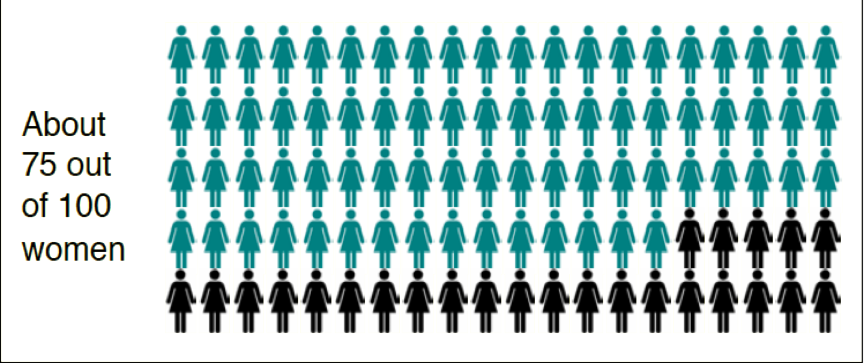
VBAC success
75% of women who plan a VBAC are successful

Slide 9
What is safest?
A successful VBAC is the least risk to mother and baby
An unsuccessful planned VBAC (needed a c/section) is the highest risk
A repeat c/section is in the middle

Slide 10
Risks with repeat c/section
Infection
Need for blood transfusion
Complications from anesthetic
Blood clots in leg
Very rare increased risk of death for mother (c/section death rate 1/10,000 and vaginal birth rate is .2/10,000)
For baby higher risk of breathing difficulties needing short stay in nursery
Higher risk of placenta issues in next pregnancies

Slide 11
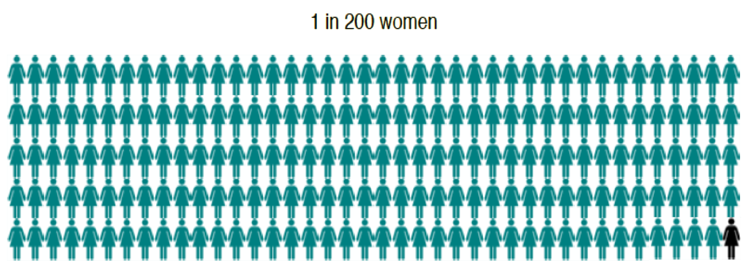
Risk with TOLAC
Risk of scar rupture-1/200 TOLAC

Slide 12
Risk with TOLAC
Risk of uterine rupture goes up slightly if labor is induced with pitocin. However, pitocin to help contractions during labor does not increase the risk
Uterine rupture requires emergency surgery to repair the uterus. Most babies and mothers make a full recovery
On rare occasions, uterine rupture can cause serious complications for mother and/or baby. There is a very small increased risk of brain damage or death of the baby and a very small increased risk of hysterectomy for the mother

Slide 13
In Labor…..
IV access (heplock is okay)
Continuous monitoring
More conservative action for concerning fetal heart tracing

Slide 14
What if I go into labor before scheduled c/section?
About 30% of women who have planned a c/section will go into labor prior to the surgery. While most women will still proceed to a c/section, some may choose to proceed with attempted vaginal birth if their labor is progressing normally.

Slide 15
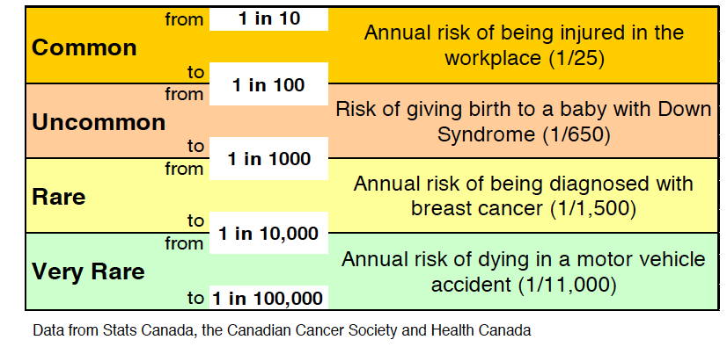
How do I compare risks?

Slide 16
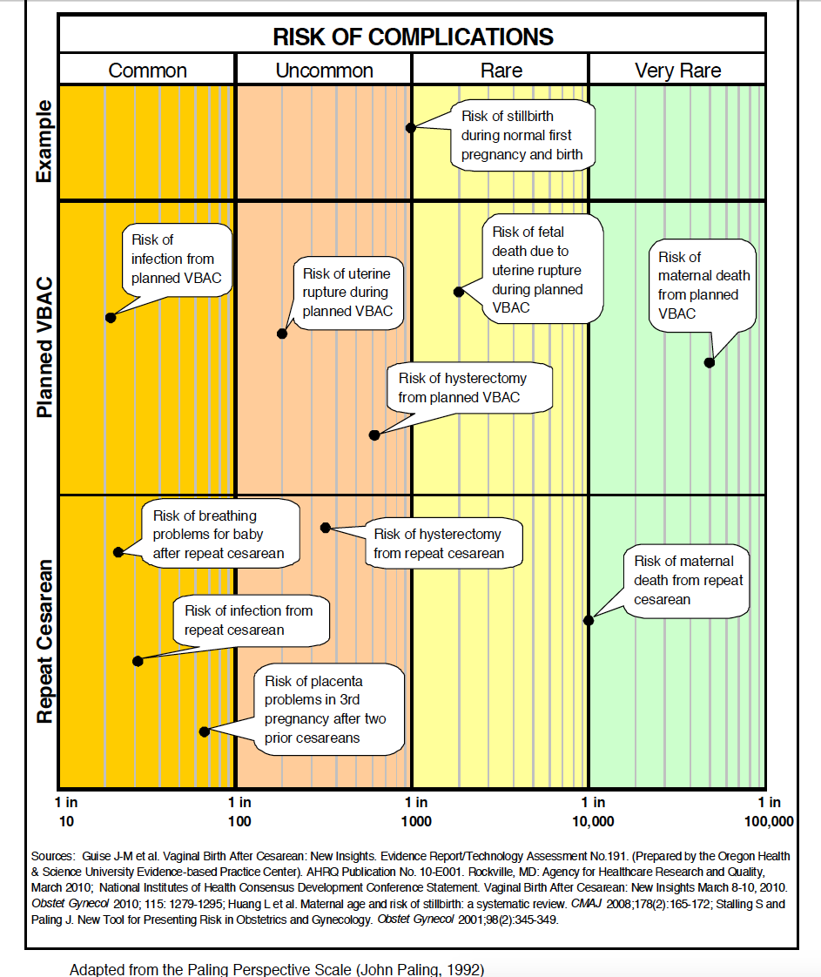

Slide 17
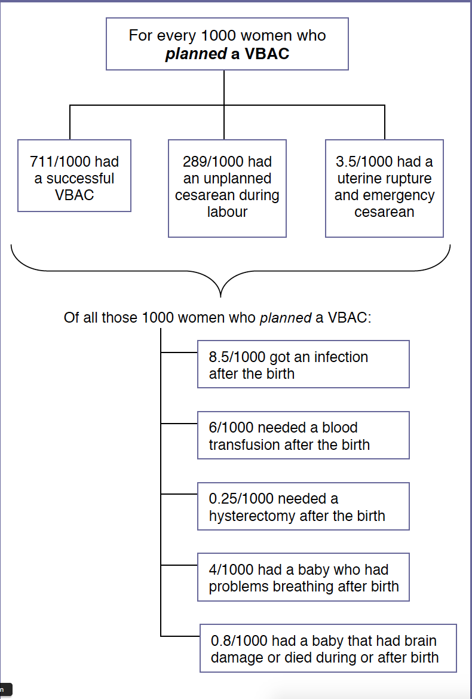

Slide 18
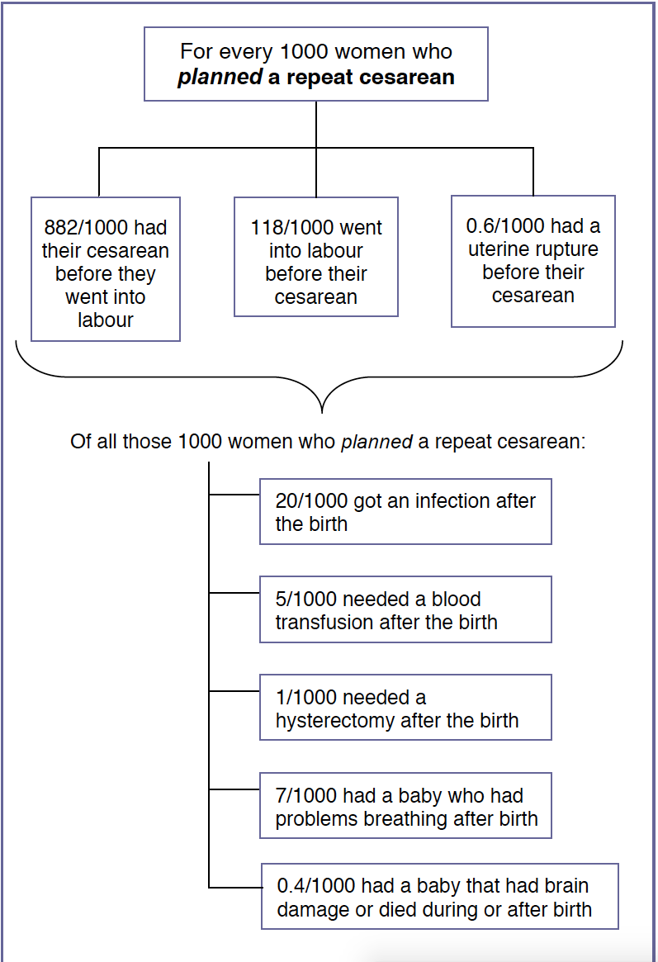

Slide 19
How to Decide
Take worksheet given here
Fill out
Take to your provider and discuss your preferences

Slide 20
